Slide 1
Session 0 - A Whole New World

Slide 2
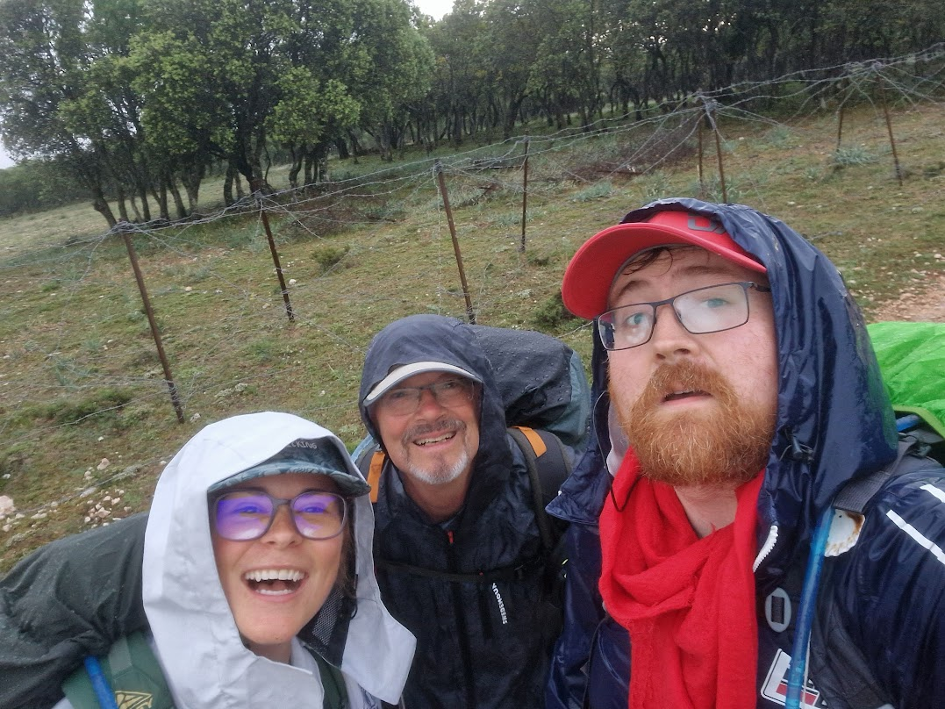
Welcome!
Welcome to the first session of this summer school!
My name is Kev O Malley, and I’m the nerd who’ll be going through this material with you

Slide 3
In this session, we’re going to:
Give you an overview of the course:
What we’re going to be doing (learning together).
Why we’re doing it (to empower each other).
What you can expect to get out of it (a sense of agency and efficacy).
Introduce you to the tools we’re going to be using (and mention some of the alternatives).
Quarto (as a tool for writing documents, reports, and papers).
Python (as a tool for doing data analysis and visualisation).
R (as an alternative to Python for doing data analysis and visualisation).
Git (as a tool for collaboration, managing your documents and code)
Accompany you through the process of producing your first documents using these tools.

Slide 4
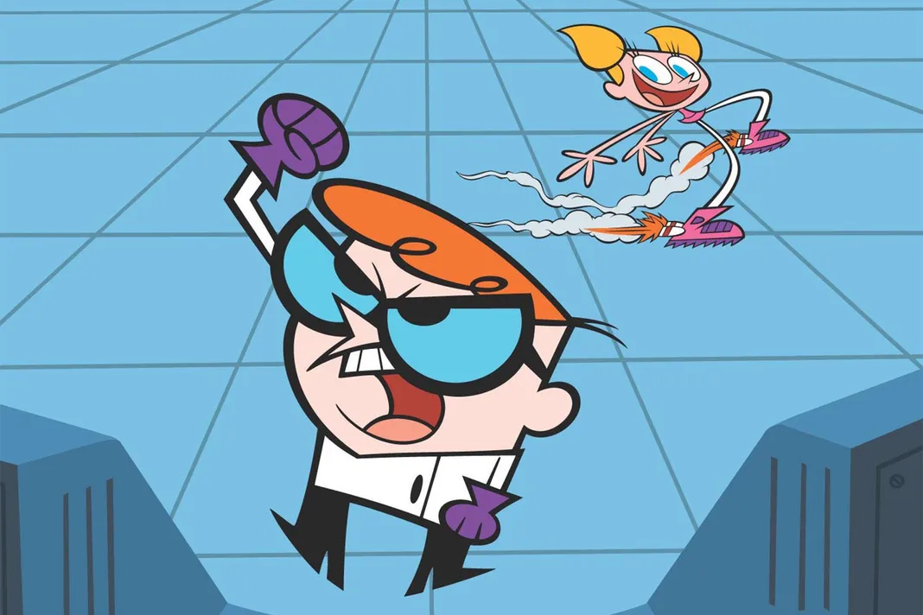
But first…
Let’s address the elephant in the room.
When you think of people who work with computers you might think of people who look like..

Slide 5
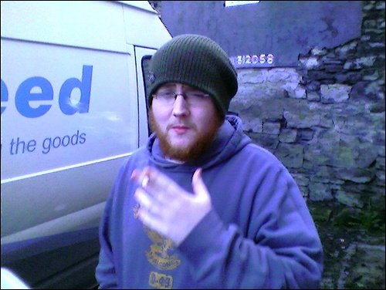
or maybe…

Slide 6
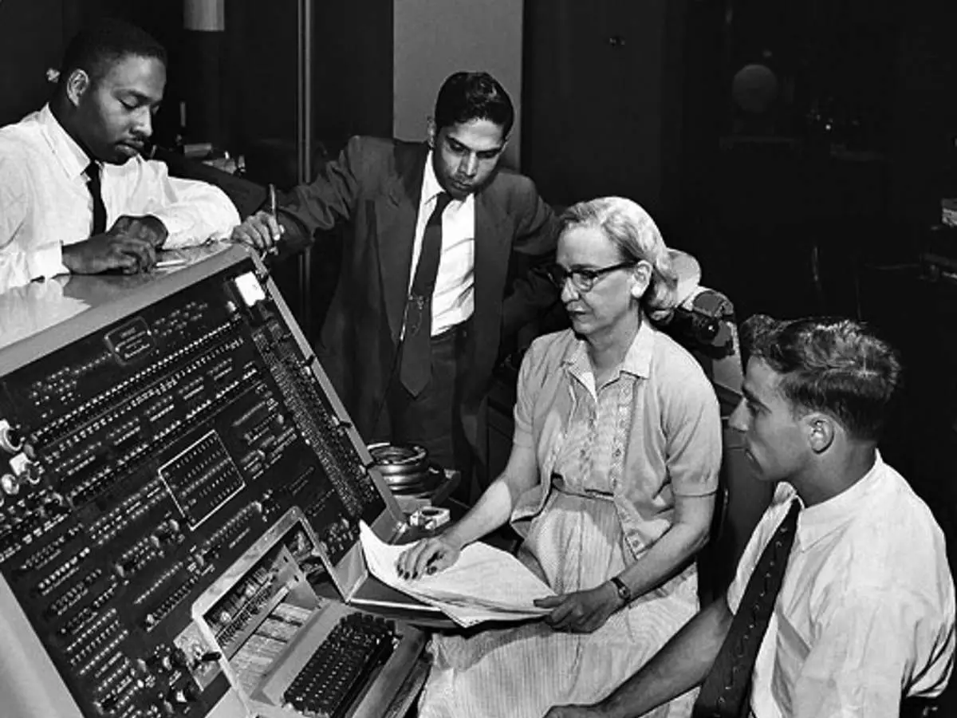
But in reality…
These tools were developed by, and are used by, people from all walks of life
AND ALWAYS HAVE BEEN

Slide 8
So let’s try to keep in mind that …
We are that which we most frequently do, excellence then, is not an act but a habit. - (Durant 1933 paraphrasing Aristotle)

Slide 9
Durant, W. 1933. The Story of Philosophy. https://books.google.ie/books?id=IAk7zgEACAAJ.

